Slide 1

Secondary
Assessment & Grade Reporting
Report to the Board of Education
November 2012

Slide 2
The Center of all of this Work
LEARNING
Notes:
The purpose behind the work we do is to promote Effective communication between teachers and students as well as their parents
Communication about students learning: Where am I now? Where or how do I need to go? And Now where am I? A strong focus on instruction and learning is what we need when we talk about assessment. It’s not only to determine a grade

Slide 3
Why Examine Assessment and Reporting at the Secondary Level?
Students, parents, and school staff need greater consistency and understanding of what their students know and can do.
Through alignment work and focus on standards-based instruction, we have more to share about student learning
Research shows that when students and teachers teach to standards – student learning increases
Our students are coming from a well-established, successful standards-based system at the elementary level
Notes:
The more clearly students/parents understand what it is we want them to learn…we need to focus on the learning beyond the grade.

Slide 4
What are the benefits of this work?
Students - a clearer understanding of what their grades mean in relation to learning, as well as knowledge of what they depth of knowledge they need to show to earn a grade
Parents - a clearer understanding of what grades mean in relation to learning, what evidence their child has given, as well as knowledge of what they depth of knowledge their student needs to show to earn a grade
Teachers/Schools - increased focus on learning as our ultimate goal as well as consistency between teachers of the same course, departments and secondary schools
Notes:
Jeff

Slide 5
K-12 TERMINOLOGY
Assessment = a measurement of student learning
  Formative Assessment – assessment used to inform instruction or give feedback to students regarding learning
  Summative Assessment – assessment at the end of a learning cycle (unit, quarter, term, semester, etc.)
Grading = correlation of a number or letter value to a level of learning
Reporting = communication of learning to students, parents and internal stakeholders
Notes:
It is critical that we all define and understand things the same. Although this slide may seem rudimentary, it is important.
Formative vs. Summative (Driver Ed. Anology)
Grading – Letter Grade (tied to standards of learning at various levels)
Reporting – Key is effective communication of learning

Slide 6
A Condensed Timeline …
Finalized Beliefs and Purpose
Began Technology Search
MS Pilot Begins
Alignment Continues
Common/Dist. Assessments Begin
Student Skills Defined
MS Piloting Continues
HS Piloting Begins
All HS Teachers Trained
Support Docs. Honed
Parents Engaged
HS – “15 Fixes” Book Study
Technology Patches
Honing of Standards
Features of Quality Assessment
Using Data to Drive Instruction
Dufour Integration
Guskey Sessions
2003-2005 | 2006 | 2007 | 2008 | 2009 | 2010 | 2011
FAMS & FAHS
Grading Committees Formed
School Grading Survey
Alignment Continues
Alignment Work Continues
All MS Teachers Trained
Began Grade Definitions
Technology Search Continues
MS New Grading Practices
Integration of Standards
Technology Roadblock
Classroom Assessment Focus
Common / District Assess Data
HS New
Grading Practices
Technology Search
Research-based
Instructional
Strategies
Notes:
Add 2012
To get to the flow chart and related products, our work started back in 2003…
Do not read each cell, but make the following points:
Not a complete listing of everything
Work NEEDED to happen over time
Consensus model used on virtually every step
Not all departments are in the same place
Belief building is BALANCED with practical application

Slide 7
Our Critical Components
Consistent Letter Grade Definitions
Consistent Grading Practices & Expectations

Slide 8
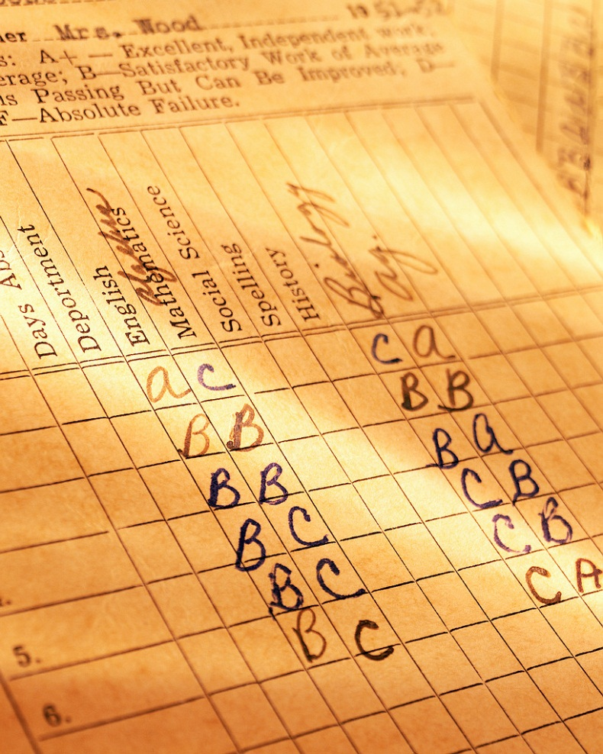
Consistent MS and HS
Letter Grade Definitions
Provides a common language, expectation and practice for 6-12 teachers
Provides opportunities to make department-level decisions
Encourages and works with a variety of assessment approaches

Slide 9
Letter Grade Definition - Sample
B | Student has a proficient understanding and/or meets course expectations | To earn an B, the student … Meets course objectives and/or demonstrates course skills at a proficient level (specific objectives to earn a B) AND/OR Demonstrates knowledge and/or skill at a proficient level according to expected curriculum level (I/D, D, D/T) AND/OR Demonstrates knowledge and/or skill for an objective(s) with at least 80% accuracy AND/OR Shows willingness to successfully extend own learning beyond basic course curriculum

Slide 10
Consistent Grading Practices & Expectations at the Secondary Level
OVERVIEW of TOPICS
Standards for LEARNING
Evidence
Assessments
Technology
Letter Grades & Report Cards

Slide 11
Consistent Grading Practices & Expectations at the Secondary Level
Standards
Each course has specific standards assigned to a reporting period (quarter) and will be used by all teachers of that course.
Each standard answers the question, “By the end of this unit or quarter, the student will know or be able to …”
Standards are derived from and/or correlated to State and National Standards (example – Common Core) when available or applicable.
Standards are shared with students and parents.
Standards become common teaching and learning goals to drive instructional and assessment decisions.

Slide 12
Consistent Grading Practices & Expectations at the Secondary Level
Evidence
The teacher is responsible for collecting evidence, by student, to determine the proficiency level (A, B, C, D or F) for that standard.
Students will be given a variety of opportunities to produce “evidence” and demonstrate their learning (homework, quiz, test, project, etc).
The teacher may utilize or “count” whatever evidence best represents the student’s depth of knowledge on a particular standard to assign a grade.
Evidence needs to be entered in to Power Teacher so students and parents can monitor their achievement on a standard.

Slide 13
Consistent Grading Practices & Expectations at the Secondary Level
Assessments
A variety of assessment types and opportunities are encouraged.
Common assessment tools are encouraged when applicable.
Assessments are correlated to specific standard(s) and designed to measure a student’s proficiency level (learning) in relation to that standard(s).

Slide 14
Consistent Grading Practices & Expectations at the Secondary Level
Letter Grades & Report Cards
Both the MS and HS will continue to use letter grades.
Both schools use a single grading scale building-wide.
Report cards will be sent to parents quarterly.
One letter grade – per course – will be communicated on the report card.
The single letter grade – per course – per reporting period – represents a composite of the student’s proficiency levels on the standards for that reporting period.

Slide 15
Consistent Grading Practices & Expectations at the Secondary Level
CONSIDERATIONS
Power Teacher Gradebook software, inherently, will always use a percent to calculate a student’s final grade.
While a teacher and student may no longer be, “playing percents” a percent calculation is still present and must be considered carefully.
Zeros are no longer used in a traditional way; however, at the HS, a new “NE” option allows teachers to assign a zero level when a student has submitted “zero” evidence.
Each teacher needs to be able to and comfortable explaining to parents, students and administration how a final letter grade was derived.

Slide 16
Technology Limitations
We are implementing our beliefs and practices related to standards-based assessment and grading.
  We do not have an ideal software tool at this time to support this way of thinking.
  Everything we do will be using the available software, Power Teacher Gradebook, to best reflect these beliefs and practices.
There is no single “perfect” or “right way” to do this in Power Teacher Gradebook.
Ideally, departments would be using a similar Power Teacher Gradebook entry to minimize student and parent confusion.
We continue to do staff development and provide support

Slide 17
Other Initiatives Working in Conjunction with the Assessment and Reporting Goals
Both MS and HS staffs continue their professional study of …
  Research-based Instructional Strategies (question #1)
  High Quality Assessment (formative & summative) (question #2)
Both support and reinforce our overall focus on increasing LEARNING

